Slide 1







Context Engineering
@rlancemartin

Slide 2
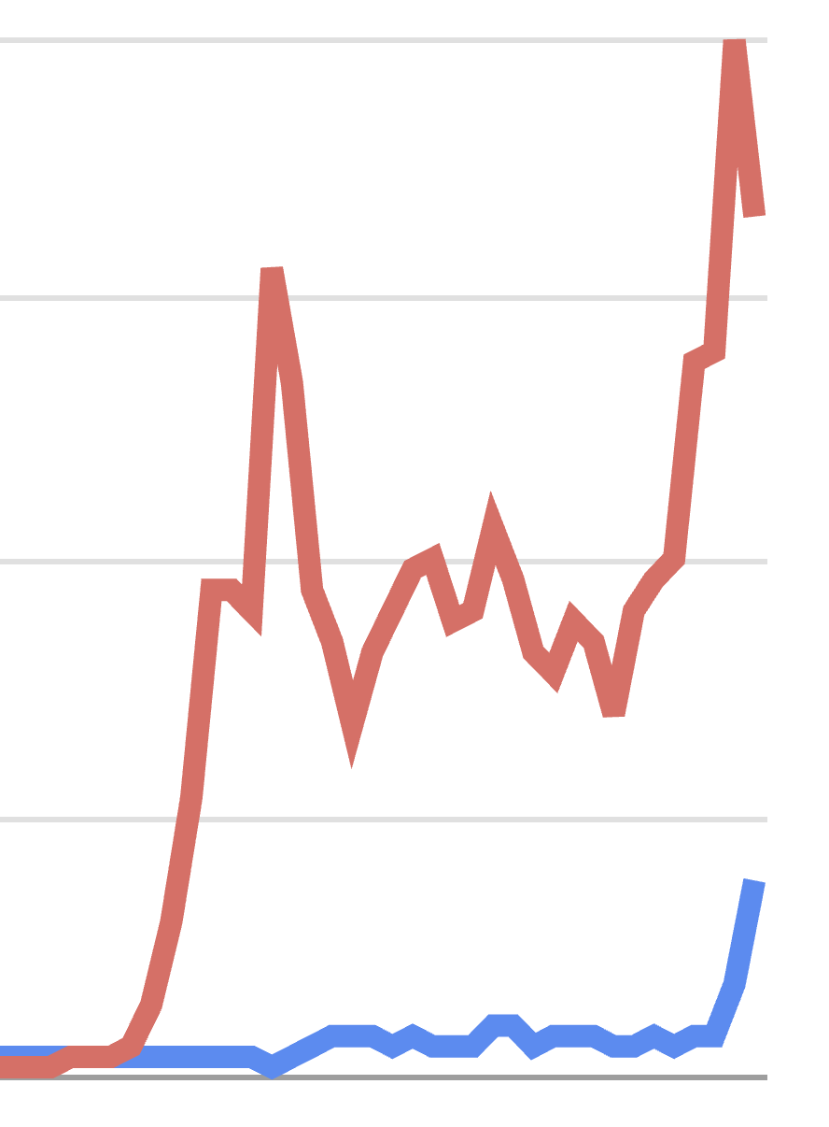
Like Drew said, buzzwords identify common experiences
Prompt engineering
Google Search Trends
Context engineering
Time
https://www.dbreunig.com/

Slide 3
ChatGPT
Prompt engineering
Context engineering
Dec, 2022

Slide 4
“Year of agents”
Prompt engineering
Context engineering
May, 2025

Slide 5
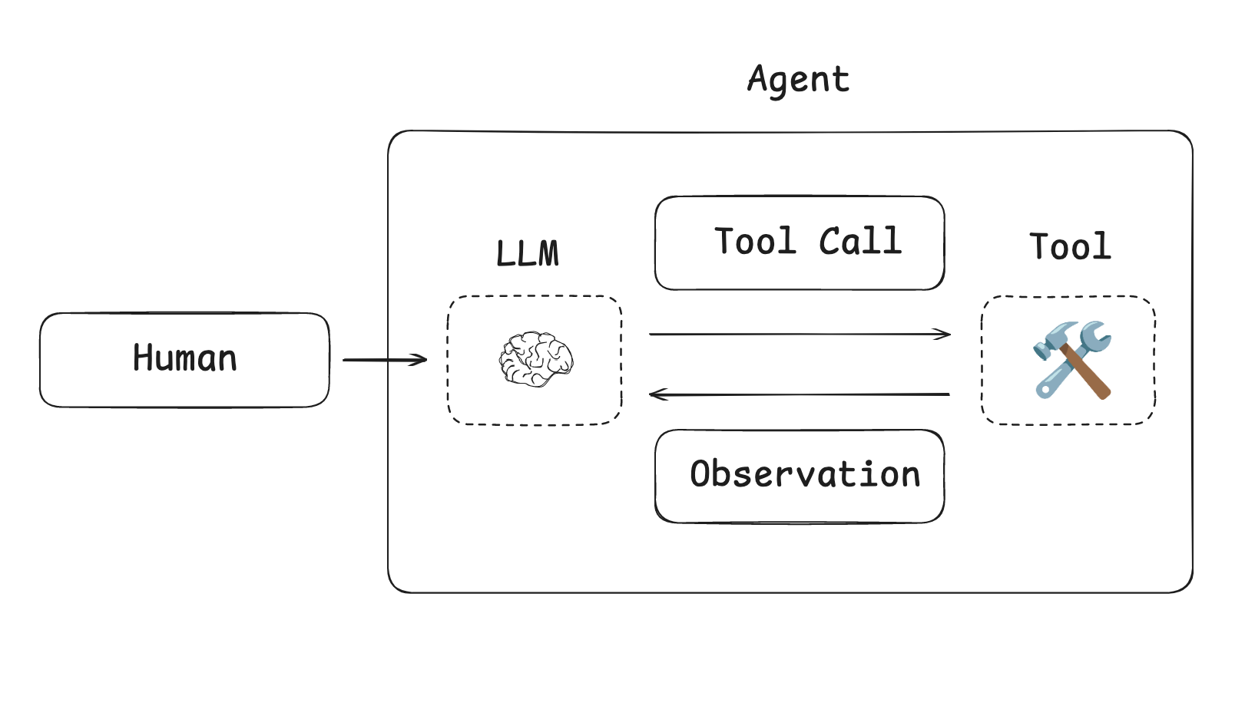
Context grows w/ agents
https://langchain-ai.github.io/langgraph/tutorials/workflows/

Slide 6
Manus
Typical task in Manus requires around 50 tool calls
Anthropic
Production agents often engage in conversations spanning hundreds of turns
https://www.anthropic.com/engineering/built-multi-agent-research-system
https://manus.im/blog/Context-Engineering-for-AI-Agents-Lessons-from-Building-Manus

Slide 7

Performance drops as context grows
https://research.trychroma.com/context-rot

Slide 8
Context Poisoning
Ex: Gemini playing Pokemon hallucinated an item + tried to re-use it
Context Distraction
Ex: Gemini favored repeated actions over new plans as context > 100k tok
Context Confusion
Ex: Models perform worse with more tools, esp if tools are similar
Context Clash
Ex: Models perform worse if back-to-back tool calls contradict each other
https://www.dbreunig.com/2025/06/22/how-contexts-fail-and-how-to-fix-them.html

Slide 9
“Context engineering” captures the challenges of the moment

Slide 10
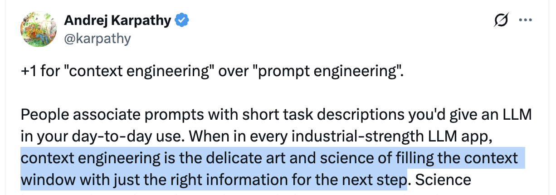
https://x.com/karpathy/status/1937902205765607626

Slide 11
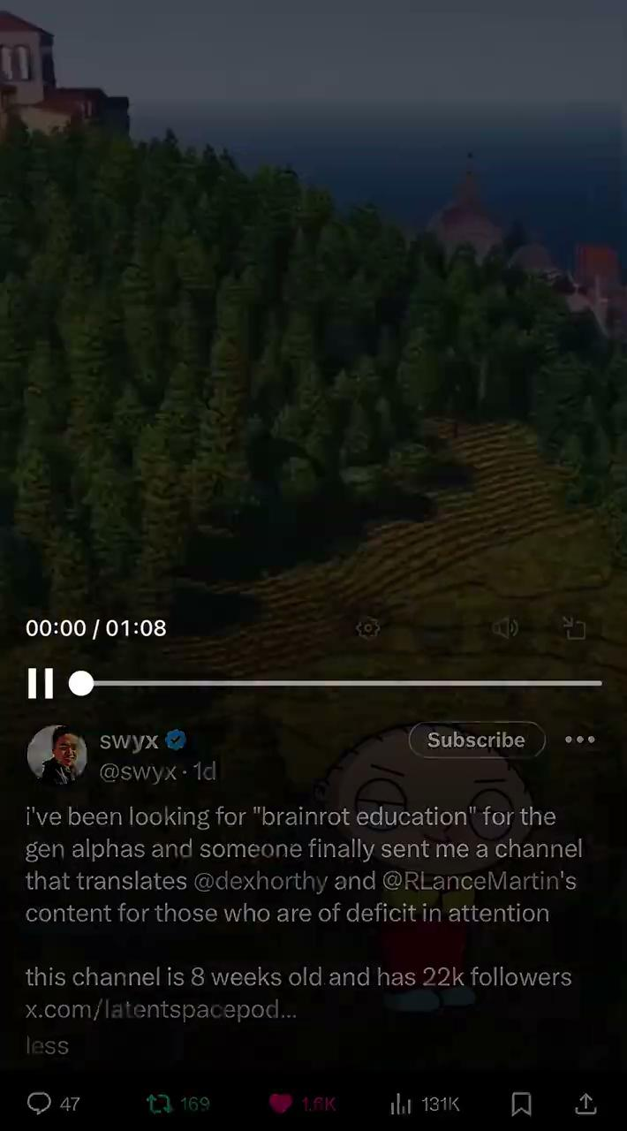
https://x.com/swyx/status/1946100121038696671

Slide 12
Many anecdotal experiences, no common philosophy yet . . .
. . . some common themes

Slide 13
Offload context
Use file system for notes (see: Drew’s post, Anthropic multi-agent).
Use file system (e.g., todo.md) to plan/track progress (see: Manus).
Use file system read/write tok-heavy context (see: Manus).
Use files for long-term memories (see: Ambient Agents course/repo).

Slide 14
Reduce context
Summarize agent message history (see: Drew’s post, Claude Code).
Prune irrelevant parts of message history (see: Drew’s post).
Summarize / prune tool call outputs (see: open-deep-research).
Summarize / prune at agent-agent handoffs (see: Cognition).
But, care careful of information loss (see: Cognition and Manus)!

Slide 15
Retrieve context
Mix of retrieval methods + re-ranking (see: Varun’s take from Windsurf).
Systems to assemble retrievals into prompts (see: Preempt in Cursor).
Retrieve relevant tools based upon tool descriptions (see: Drew’s post).

Slide 16
Isolate context
Split context across multi-agents (see: Drew’s post, Anthropic).
But, be careful (see: Cognition/Walden Yan)!
Multi-agents make conflicting decisions (see: Cognition/Walden Yan).
Sub-agents lower risk if avoid decisions (see: open-deep-research).

Slide 17
Cache Context
Cached input tokens for Claude-sonnet 10x cheaper!
Cache agent instructions, tool descriptions to prefix.
Add mutable context / recent observations to suffix.
https://manus.im/blog/Context-Engineering-for-AI-Agents-Lessons-from-Building-Manus

Slide 18
Let’s see an example

Slide 19
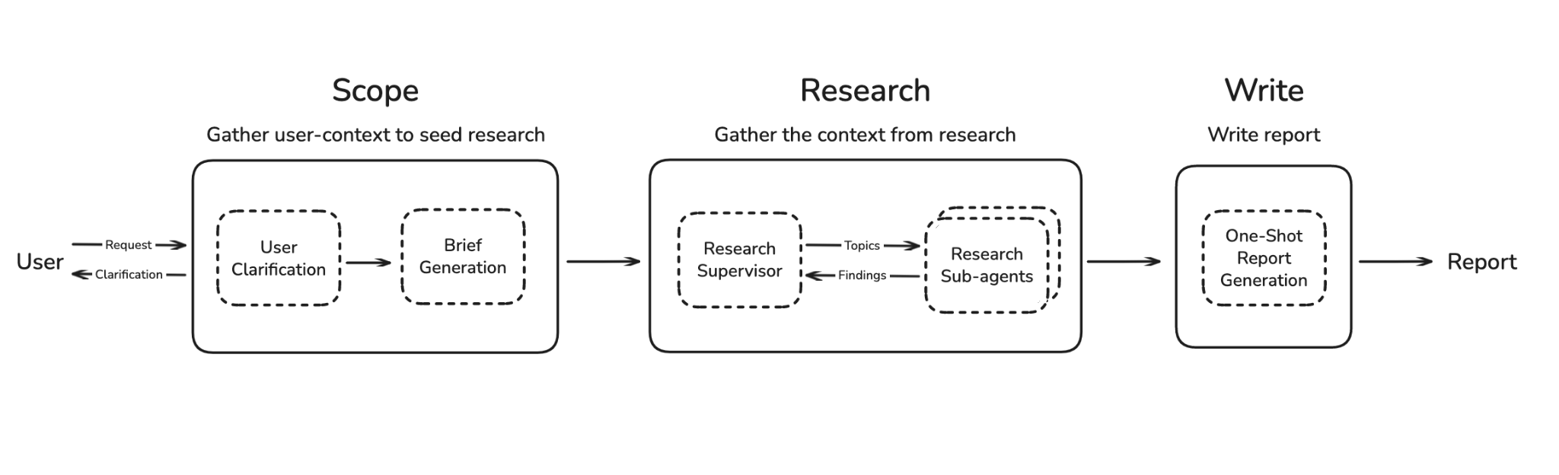
https://blog.langchain.com/open-deep-research/
https://github.com/langchain-ai/open_deep_research

Slide 20
Offload: Create brief from chat and save to state.
https://blog.langchain.com/open-deep-research/
https://github.com/langchain-ai/open_deep_research

Slide 21
Offload: Use brief later to steer writing/research.
https://blog.langchain.com/open-deep-research/
https://github.com/langchain-ai/open_deep_research

Slide 22
Reduce: Summarize the observations from tool calls + agent research.
https://blog.langchain.com/open-deep-research/
https://github.com/langchain-ai/open_deep_research

Slide 23
Isolate: Isolate context across sub-agents.
https://blog.langchain.com/open-deep-research/
https://github.com/langchain-ai/open_deep_research

Slide 24
 | Offload | Reduce | Retrieve | Isolate | Cache
Drew’s Post | Discussed | Discussed | Discussed | Discussed | Not discussed
Manus | Used | Discouraged [1] | Not discussed | Not discussed | Used
Anthropic-researcher | Used | Used | Used | Used | Not discussed
Cognition | Not discussed | Used | Not discussed | Discouraged [2] | Not discussed
LC open-deep-research | Used | Used | Used | Used | Not discussed
[1] Information loss risk w compression is a problem. Favors offloading instead.
[2] Coordination problems w multi-agent is a risk.

Slide 25
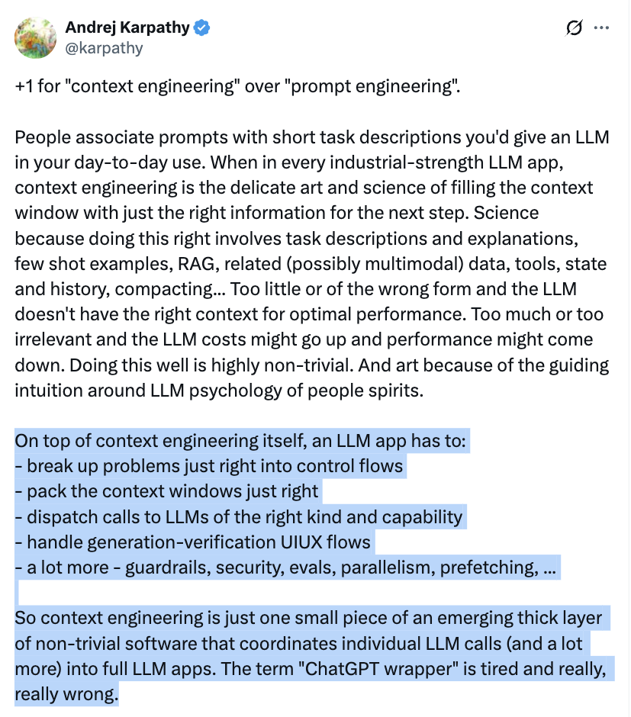

Slide 26
https://github.com/langchain-ai/how_to_fix_your_context

